Slide 1
Disability & Health Football Development Officer | Hampshire FA
EMPLOYMENT APPLICATION PACK:
Disability & Health Football Development Officer

Slide 2
Disability & Health Football Development Officer | Hampshire FA
WHAT IS IN THIS PACK?
1 Job Advert & Description
2 Application Process
3 Full Role Profile & Person Specification
4 Glossary of Terms
If you would like to discuss the role further or have any questions, please contact Pedro Viveiros (E: Pedro.Viveiros@HampshireFA.com | T: 01256 853 015)
WHY WORK FOR HAMPSHIRE FA
We are committed to providing a positive culture for our people to thrive as part of our 2024-28 strategy. As such and to support our workforce, we offer a range of exciting benefits, including…
25 days leave (plus bank holidays) & an additional day for your birthday
Up to two volunteer days per season to support local causes
Time off in lieu of out-of-hours working
A hybrid working model offering greater flexibility
A contributory pension scheme
Cycle to Work salary sacrifice scheme
SimplyHealth claim back scheme & online GP for your health needs (more info)
Culture Club - a group of staff reps delivering peer to peer support & team building activities during the working week

Slide 3
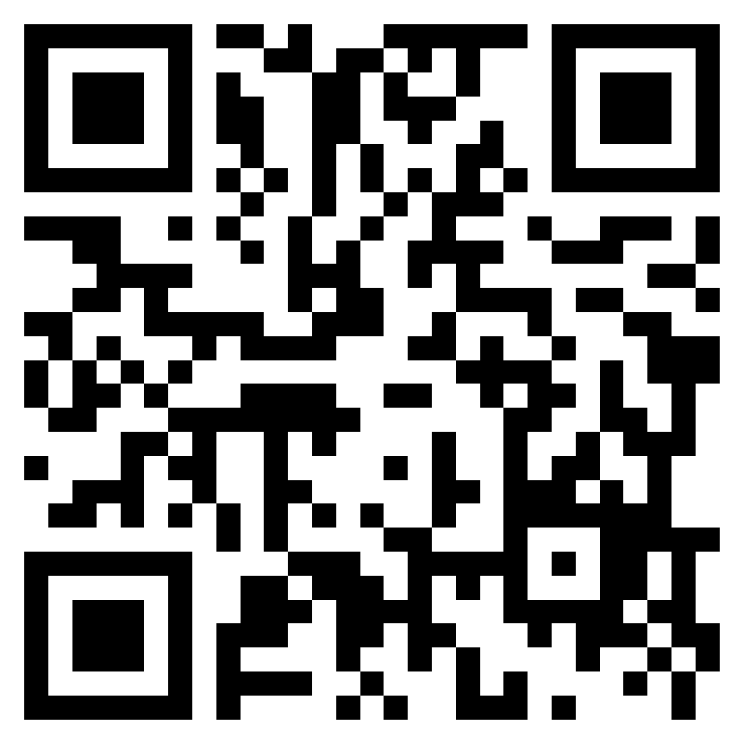
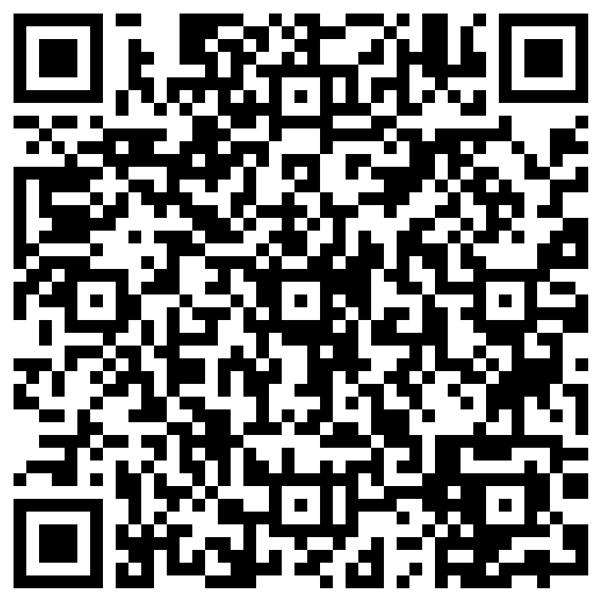
Disability & Health Football Development Officer | Hampshire FA
Disability & Health Football Development Officer
Salary: circa £25,000 per annum Contract: FT to 30th June 2028
What is the role?
We are looking for someone to drive the strategic development of Disability Football in Hampshire, lead programmes and initiatives focussed on men's health, and champion the growth of Walking Football across the county.
What will you do?
You will lead the strategic development of the Disability Football pathway in Hampshire
You will lead the growth of Walking Football provision in Hampshire
You will explore new and innovative ways of reducing inequalities in men’s health
You will ensure disability football in Hampshire is safe, fun, and inclusive
What do you need?
The ability to build and maintain working relationships
The ability to work independently and as part of a team
The ability to work around challenges by developing new solutions
The determination to fail better - try > fail > learn > repeat
Applications by 15th October:
To apply complete the online application form. Interviews will take place in person on Wednesday 23rd October at Winklebury Football Complex.
Access the form by scanning this QR code with a smartphone:
Or via :
https://forms.office.com/e/5DjQPEMsWB
Virtual Information Evening:
To learn more about the role join us virtually on Monday 30th September at 6pm.
Register by scanning this QR code with a smartphone:
Or via:
https://forms.office.com/e/qMehym0r26

Slide 4
Disability & Health Football Development Officer | Hampshire FA
APPLICATION PROCESS
Please see the accompanying advert & job description, full role profile & person specification, and supporting information. These should be used as a guide when completing the application form. The application form can be made available in alternative formats and should this be required please contact us to advise of your requirements.
Please complete the application form by clicking here.
If shortlisted, you will be invited to interview for the role. The exact format of the interview will be confirmed with notice of the interview and reasonable adjustments can be made to accommodate any needs you may have.
Hampshire FA have an understanding and commitment to equality, diversity and inclusion and would be grateful if you could complete an anonymous equality monitoring form as part of your application. By completing this questionnaire, you are helping us to plan for the future and ensure we recruit from a diverse pool of applicants that are appropriate and relevant to the community we serve.
Please complete the equality monitoring form by clicking here.
Hampshire FA are committed to safeguarding children and adults at risk. Due to the nature of this role, the successful candidate will be required to undertake a Disclosure and Barring Service (DBS) check through the FA DBS process. The possession of a criminal record will not necessarily prevent an applicant from obtaining this post, as all cases are judged individually according to the nature of the role and information provided.
Key Dates:
Virtual Information Evening – Monday 30th September 2024 (Online)
Application closing date – Tuesday 15th October 2024
Interview date – Wednesday 23rd October 2024 (In Person @ Winklebury Football Complex, RG23 8BF)

Slide 5
Disability & Health Football Development Officer | Hampshire FA
FULL ROLE PROFILE & PERSON SPECIFICATION
Hampshire FA are an equal opportunities employer and actively encourage people from diverse backgrounds to apply for all roles.
Job title | Disability & Health Football Development Officer
Reports to | Football Development Manager
Job purpose(s) | To support the delivery of The FA Grassroots Football Strategy, The FA Disability Football Gameplan, and the Hampshire FA Business Strategy To strategically coordinate Disability Football provision and men's health programmes across Hampshire To lead Hampshire FA Walking Football provision to increase activity To contribute to the effective implementation of The FA’s Safeguarding 365 Operating Standard for County FAs.
Direct reports | 2 x Disability Football Ambassadors
Location | Winklebury Football Complex, Basingstoke, RG23 8BF (Hybrid Working Policy currently in operation providing mix of office/remote working)
Working hours | 35 hours a week, occasional evening/weekend work required (Flexible options available - job share, part-time, etc)
Contract type | Full-time contract to 30th June 2028 (Further extension subject to funding renewal)
Salary | Circa £25,000 per annum
Roles & Responsibilities:
Representing Hampshire FA | Actively deliver against Company Values, Behaviours, and the Customer Charter. Actively challenge all forms of discrimination in grassroots football. Utilise hub sites as a resource to deliver programmes and further Hampshire FA’s reputation as a facility provider.
Disability Football Pathway | Work collaboratively with local stakeholders to grow and retain team-based and sessional-based playing opportunities. Map existing casual and team-based playing opportunities and target gaps in provision across key programmes, age groups, and formats. Lead on the growth and development of the EFCCT Pan-Disability League across all ages and formats of the game. Retain and grow the number of affiliated Disability Football teams with an emphasis on creating player pathway opportunities within England Football Accredited clubs. Retain and grow the number of casual playing opportunities using FA programmes such as Comets and Just Play. Embed research and insight into planning, decision-making, and delivery to meet the needs of Disabled people. Facilitate the movement of Disabled players transitioning from youth to adult football. Utilise the feedback from under-18s and adults at risk to enhance the experience, fun, and safety in grassroots football. Support the development of associated workforce to ensure all Disability Football is safe and sustainable.
Men’s Health Inequalities | Maintain and develop relationships with existing recreational providers and champion their transition to Clubspark. Lead the development and delivery of men’s recreational sessions to reduce mental and physical health inequalities. Map existing provision and identify gaps for development. Apply for external funding in conjunction with the Hampshire FA CSR Group to support the creation of new programmes.
Walking Football | Lead delivery of Hampshire FA Walking Football Steering Group to consult with members on the future development. Lead Hampshire FA Walking Football League Over 50’s & Over 60’s delivery. Lead FA Walking Football Cup local qualifiers and provide support and advice to recreational Walking Football providers. Provide the highest level of customer excellence to support volunteers across all FA Technology systems (FA Learning, FA Events, Whole Game System, Matchday app, and Full-Time).
Safeguarding | Support maintenance of FA safeguarding 365 operating standards and ensure that the safeguarding of young people and vulnerable adults is prioritised at all times. Carry out appropriate Safeguarding Risk Assessments for any activities delivered. Ensure that all participants and their families are aware and encouraged to report any safeguarding concerns. Listen to and consult with under-18s on their experiences of grassroots football as part of the Hampshire FA Youth Engagement Strategy.

Slide 6
Disability & Health Football Development Officer | Hampshire FA
Equality, Diversity & Inclusion | Ensure that disability football is inclusive, diverse, and representative of local communities. Consult with the Hampshire FA Inclusion Advisory Group (IAG) on key priorities and developments. Use national and local data, research, and community insights to diversify participation.
People | Line manage and mentor 2 x Disability Football Ambassadors.
Finance | Manage budget for area of Business Strategy and adhere to Hampshire FA finance protocols, processing payments, and invoices as required. Identify sources of funding that will be of benefit to grassroots football and to reduce inequalities in men's health. Apply for the FA Journey to Inclusion Fund and Hampshire Foundation as required.
 | Skills | Knowledge/Experience
Essential (Required to fulfil role) | Ability to build and maintain working relationships with partner organisations. Ability to work independently and as part of a team. Ability to think creatively and demonstrate a passion for problem-solving. Ability to communicate effectively to different audiences. | Educated to A Level or equivalent. Lived experience of having a disability or working with disabled people. Knowledge or experience of reducing inequalities in men’s health. Experience of developing relationships with a wide range of people.
Non-Essential (Beneficial but can be accumulated once in the role) | Ability to monitor, evaluate, and demonstrate impact of programmes. Time management and prioritisation to meet deadlines. Proficient IT skills, including the use of Microsoft Office applications. Ability to create and monitor financial budgets, reports, and plans. Ability to provide excellent customer service. | Experience of working with volunteers. Experience of project management. Two years’ sports development experience or in an equivalent field. Awareness of key national and local football organisations and partners. Working knowledge of The FA’s Grassroots Football Strategy. Working knowledge of Equality, Diversity, Inclusion, and Safeguarding.
HFA Values | Expected Behaviours
PROGRESSIVE | Identifies the need for, and actions change in direction, practice, policy, or procedure. Questions the way things are done and takes informed risks. Continuously seeks to improve efficiency and performance.
RESPECTFUL | Maintains people’s self-esteem when interacting with them. Avoids pre-judgement when listening to suggestions from others. Seizes the opportunity to apply Hampshire FA standards at all times.
INCLUSIVE | Openly collaborates with colleagues and partners in the game. Provides equal opportunity to people of different backgrounds, experience, and perspective. Seeks out and embraces new ways of thinking and working.
DETERMINED | Works relentlessly to overcome roadblocks or obstacles to achieve the goal. Remains focused on seeing agreed goals through to completion taking pride in their work. Maintains motivation for their team and themselves.
EXCELLENT | Seeks to achieve the highest levels of performance at all times. Can be committed to achieve a standard that others consider impossible. Supports others to go further and achieve more.
Application Deadline: | Tuesday 15th October 2024
Interviews to be held: | Wednesday 23rd October 2024

Slide 7
Disability & Health Football Development Officer | Hampshire FA
Glossary of Terms
Hampshire FA are an equal opportunities employer and actively encourage people from diverse backgrounds to apply for all roles. Some of the terms and abbreviations used in this job application pack may be seen as a barrier to apply so we wanted to clarify their meaning to be more inclusive and make the role accessible to more people from diverse backgrounds.
Term | Meaning
Team-based playing opportunities | Refers to playing competitive football as part of a team within a league structure. Clubs often run this type of football, where clubs compete against each other.
Sessional-based playing opportunities | Refers to recreational or casual football. Clubs, leisure centres, and private sport organisations often run this format of football. These sessions are beginner friendly, fun, and not competitive.
EFCCT Pan-Disability League | Stands for the 'Eastleigh Football Club Community Trust Pan-Disability League'. They are the only pan-disability league in Hampshire and a key partner for the post holder to work with.
England Football Accredited Clubs | England Football Accreditation is a Standard that clubs achieve if their football offer is safe, fun, and inclusive. The post holder will need to work with England Football Accredited clubs to grow the disability pathway.
Comets | Comets is a recreational, pan-disability football programme for disabled boys and girls aged between 5 and 11. Comets is funded by The FA and delivered by clubs.
Just Play | Just Play is a recreational football programme for adults aged 16+ of all abilities.
Hampshire FA’ CSR Group | Hampshire FA's staff-led 'Corporate Social Responsibility' Group supports local charitable causes.
Disability Football Ambassadors | The Disability Football Ambassadors support England Football Accredited Clubs to create more club-based opportunities for disabled people to play, coach, or volunteer.
IAG | Hampshire FA's Inclusion Advisory Group consists of staff, directors, and local community members. The group monitors the successful delivery of Hampshire FA's EDI Strategy.
Mens Health Inequalities | In the UK, several physical and mental health conditions disproportionately impact men. Men are more likely to experience poor health outcomes for a variety of conditions. The incoming post holder will be expected to develop projects that would positively impact men's health conditions.

